Slide 1
Section 12-2: Measures of Central Tendency
Find and interpret means.
Find and interpret medians.
Find and interpret modes.
Infer central tendency measures from stem-and-leaf displays.
Discern symmetry in data sets.
Compare measures of central tendency.

Slide 2
Measures of Central Tendency
For a given set of numbers, it may be desirable to have a single number to serve as a kind of representative value around which all the numbers in the set tend to cluster, a kind of “middle” number or a measure of central tendency. Three such measures are discussed in this section.

Slide 3
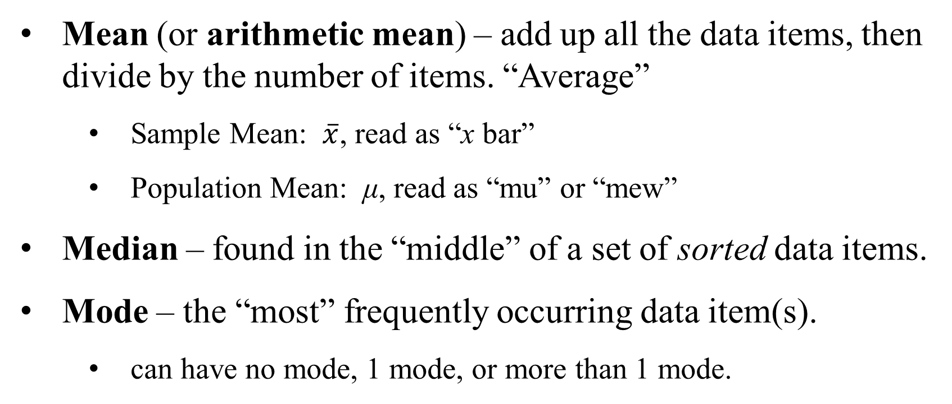
Measures of Central Tendency – Summary Overview
Mean (or arithmetic mean) – add up all the data items, then divide by the number of items. “Average”
Sample Mean: $\overline{x}$, read as “x bar”
Population Mean: μ, read as “mu” or “mew”
Median – found in the “middle” of a set of sorted data items.
Mode – the “most” frequently occurring data item(s).
can have no mode, 1 mode, or more than 1 mode.

Slide 4
Mean
The mean of n data items x₁, x₂,…, x_{n}, is given by the formula
We use the symbol for “summation,” (the Greek letter sigma).

Slide 5
Example: Finding the Mean Number of Siblings
Ten students in a math class were polled as to the number of siblings in their individual families and the results were: 3, 2, 2, 1, 3, 6, 3, 3, 4, 2. Find the mean number of siblings for the ten students.
Solution
The mean number of siblings is 2.9.

Slide 6
Example: Finding Grade Point Average (Weighted Mean)
In a common system for finding a grade-point average, an A grade is assigned 4 points, with 3 points for a B, 2 for C, and 1 for D.
Find the grade-point average by multiplying the number of units for a course and the number assigned to each grade, and then adding these products.
Finally, divide this sum by the total number of units. This calculation of a grade-point average in an example of a weighted mean.

Slide 7
Example: Finding Grade Point Average
Find the grade-point average (weighted mean) for the grades below.
Course | Grade Points | Units (credits)
Math | 4 (A) | 5
History | 3 (B) | 3
Health | 4 (A) | 2
Art | 2 (C) | 2

Slide 8
Example: Finding Grade Point Average
Solution
Course | Grade Pts | Units | (Grade pts)∙(units)
Math | 4 (A) | 5 | 20
History | 3 (B) | 3 | 9
Health | 4 (A) | 2 | 8
Art | 2 (C) | 2 | 4
Totals |  | 12 | 41
Grade-point average =

Slide 9
Median
Another measure of central tendency, which is not so sensitive to extreme values, is the median.
This measure divides a group of numbers into two parts, with half the numbers below the median and half above it.

Slide 10
Median
To find the median of a group of items:
Step 1 Sort the items (that is, arrange them in numerical order from least to greatest).
Step2 If the number of items is odd, the median is the middle item in the list.
Step 3 If the number of items is even, the median is the mean of the two middle numbers.

Slide 11
Example: Finding the Median
Ten students in a math class were polled as to the number of siblings in their individual families and the results were: 3, 2, 2, 1, 1, 6, 3, 3, 4, 2.
Find the median number of siblings for the ten students.
Solution
In order: 1, 1, 2, 2, 2, 3, 3, 3, 4, 6
Median = (2+3)/2 = 2.5

Slide 12
Position of the Median in a Frequency Distribution
Position of median =
Notice that this formula gives the position, and not the actual value.

Slide 13
Example: Finding Medians for a Frequency Distribution
Find the median for the distribution.
Value | 1 | 2 | 3 | 4 | 5
Frequency | 4 | 3 | 2 | 6 | 8
Solution
Position of median =
The median is the 12th item, which is a 4.

Slide 14
Mode
The mode of a data set is the value that occurs the most often.
Sometimes, a distribution is bimodal (literally, “two modes”). In a large distribution, this term is commonly applied even when the two modes do not have exactly the same frequency.

Slide 15
Example: Finding Modes for a Set of Data
Ten students in a math class were polled as to the number of siblings in their individual families and the results were: 3, 2, 2, 1, 3, 6, 3, 3, 4, 2.
Find the mode for the number of siblings.
Solution
3, 2, 2, 1, 3, 6, 3, 3, 4, 2
The mode for the number of siblings is 3.

Slide 16
Example: Finding Modes for a Set of Data
Find the mode for the distribution.
Value | 1 | 2 | 3 | 4 | 5
Frequency | 4 | 3 | 2 | 6 | 8
Solution
The mode is 5 since it has the highest frequency (8).

Slide 17
Example: Finding Median and Mode from a Stem-and-Leaf Display
Below is a stem-and-leaf display of some data. Find the median and mode.
We can calculate measures of central tendency from a stem-and-leaf display. The median and mode are easily identified when the “leaves” are sorted (in numerical order) on their “stems.”
1 | 5 6
2 | 0 7 8 9 9
3 | 6 6 7 7
4 | 0 2 2 2 3 6
5 | 1 6 8 8
Median
MEDIAN is 37
MODE is 42
Mode

Slide 18
Symmetry in Data Sets
The most useful way to analyze a data set often depends on whether the distribution is symmetric or non-symmetric.
In a “symmetric” distribution, as we move out from a central point, the pattern of frequencies is the same (or nearly so) to the left and right.
In a “non-symmetric” distribution, the patterns to the left and right are different.

Slide 19
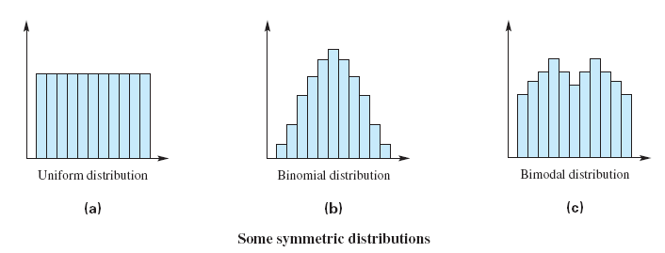
Some Symmetric Distributions

Slide 20
Non-symmetric Distributions
A non-symmetric distribution with a tail extending out to the left, shaped like a J, is called skewed to the left.
“Skinny left” = Skewed left
If the tail extends out to the right, the distribution is skewed to the right.
“Skinny right” = Skewed right

Slide 21
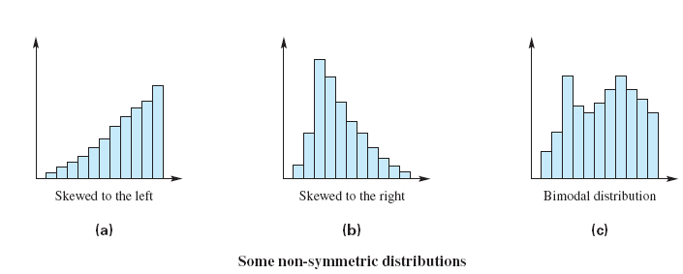
Some Non-symmetric Distributions

